Slide 1
Welcome
To
National History
Day

Slide 2
Welcome to National History Day in Colorado
NHDC is a skills-based history and literacy curriculum that allows teachers to integrate research, writing and presentation skills into the history classroom.
The focus of NHDC is the growth that happens for students. The competition phase is a fun way for students to receive recognition and feedback about the work they have done.

Slide 3
History Day is…
more than just a day. It is an adventure!
a platform for teaching real-life skills
flexible
fun
a great way to provide success for students who might not succeed in other areas
compatible with Common Core Standards
a solution for the college remediation trend

Slide 4
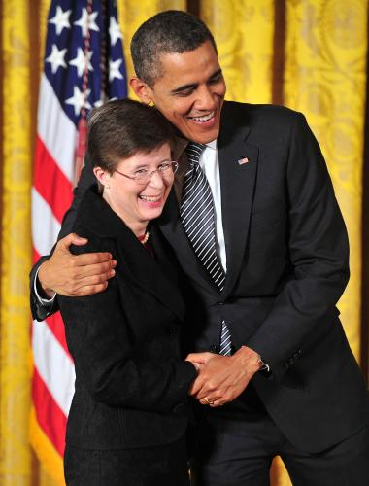
Even the President Loves NHD
National Director Kathy Gorn accepts the National Medal for the Humanities in 2012.

Slide 5
A recent national study showed…
NHD students outperform their non-NHD peers on state standardized tests, not only in social studies, but in reading, science and math as well.
NHD students are better writers, who write with a purpose and real voice, and marshal solid evidence to support their point of view.
NHD students are critical thinkers who can digest, analyze and synthesize information.
NHD students learn 21st century skills. They learn how to collaborate with team members, talk to experts, manage their time and persevere.
NHD has a positive impact among students whose interests in academic subjects may wane in high school.
source: www.nhd.org/nhdworks

Slide 6
The Nuts and Bolts of National History Day
Jr. and Sr. Division
Individual and Group projects
Five project categories
Documentary Film
Tabletop Exhibit
Research Paper
Performance
Website

Slide 7
NHD is what you make it!
Club or enrichment activity
G/T or Special needs project
Unit of study project
Long-term integrated project
Final project
Challenge project for interested students
Please refer to the ideas in your packet of materials.

Slide 8
Making History Day Work
Create a timeline:
Begin with the contest date and work backwards
Consider whether you will need to have a local contest.
Greater Denver Metro limits entries to 3 per category per school. Encourage your students to diversify.
Set benchmarks dates and student/teacher consultations
Something should be due at each consultation
Remember to work in an evaluation

Slide 9
Group or Individual?
 | Pros | Cons
Individual | Student has independence Decisions are easier Student can work when and where they want There will not be differences in opinion or work ethic | Student will be responsible for all costs There is not an opportunity for collaboration Student won’t have a partner to help motivation
Group | Students improve collaborative skills Students share project costs Students help each other with decision-making Group members can draw on one another’s strengths | Students might have difficulty scheduling times to work Group members might have different opinions Students in a group might have work ethic differences Group work demands communication

Slide 10
Student Contract
Consider requiring students to sign a contract.
Having students sign asks them to make a commitment, especially if they are a part of a group.
Having parents sign ensures that students will be available for the competition.
An example of a student contract can be found in your materials.

Slide 11
Choosing a topic
Interest: Baseball
Theme: Turning Points in History
Broad Topic: Breaking the Color Barrier
Narrow Focus:
Branch Rickey
signs Jackie
Robinson

Slide 12
Choosing a topic
Interest: The Civil War
Theme: Turning Points in History
Broad Topic: Women Spies of the Civil War
Narrow Focus:
Rose Greenhow

Slide 13
Thesis statements
A good thesis statement…
explains the significance of the subject matter.
tells what to expect from the project. In other words, it is a road map.
directly addresses the theme as it relates to the topic.
makes a claim that others might dispute.
must be proven through the project.
Students might have a working thesis statement that they refine as they complete the project.

Slide 14
Thesis samples
Poor example:
Martin Luther was born in 1483. He started the Reformation.
Better Example:
Martin Luther disagreed with aspects of the Roman Catholic religion, specifically the sale of indulgences, religious corruption and the doctrine of salvation through good works. His protest and struggle with the Catholic Church, and the subsequent formation of the Protestant Church, were a turning point in world history.

Slide 15
Thesis samples
Poor Example:
I am going to tell you about Branch Rickey and Jackie Robinson.
Better Example:
Jackie Robinson played baseball at a time when teams were segregated, black from white. With the assistance of team manager Branch Rickey, Robinson made strides toward desegregation as the first black player with the Brooklyn Dodgers. He left a legacy, opening professional sports to African American athletes.

Slide 16
TOPIC+THEME+IMPACT=THESIS
In the beginning, students will not know the impact. That is okay. This is a working thesis that will evolve through their research.

Slide 17
Guiding Student Research
Students should show balanced research.
Students should use both primary and secondary sources.
Students should use a variety of sources
Books, articles, documentaries
Archives and museum collections
Interviews
Internet sources
Librarian Help
Denver Public Library main branch has an NHD help program
Check out NHDC’s “Research Rendezvous” program
Arapahoe Libraries has a rent-a-librarian program

Slide 18
Evaluating Internet Sources
It is important to use internet sources that are reliable.
Tell students they should only use a website if they know who it is produced by.
A site hosted by “The National Archives” is more likely to have accurate information than a site created by “Miss Butcher’s 6th grade history class”.
Use the CARS checklist to evaluate whether a website is a good source.

Slide 19
CARS Checklist
Credibility: Look for websites that are an
authoritative source, a source that supplies some good evidence that
allows you to trust it.
Accuracy: Look for websites that are current
and give the whole truth.
Reasonableness: Look for sources that look at
the subject thoughtfully and reasonably and are concerned with the truth.
Support: Look for websites that provide convincing evidence for the claims they make. Does the website use primary sources to support their claims?

Slide 20
Good internet resources
The Library of Congress (www.loc.gov )
American Memory Project
Chronicling America
National Archives(www.digitalvaults.org or www.archives.gov )
Our Documents (www.ourdocuments.gov )
American Journeys (www.americanjourneys.org)
Colorado Historical Society Archives
(www.historycolorado.org )
Colorado Historic Newspaper Collection
(www.coloradohistoricnewspapers.org )
These and other resources are linked at:
www.nhddenver.org
www.nationalhistorydayincolorado.org

Slide 21
Wikipedia
should NEVER be cited as a source
It can be a great place for initial research, but the judges like to see sources that are accepted as more credible

Slide 22
Notetaking
One of the most important elements of NHD research is tracking sources.
There is no set number of sources a project should have.
Some projects might have 30+ sources, so keeping track of them is critical.
Require your students to keep notecards or a research log, and check it when you have consultations.
This research log will be necessary as students create their annotated bibliography.

Slide 23
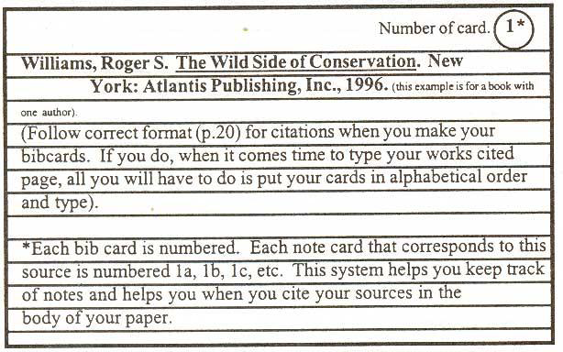
Notetaking options
Notecards

Slide 24
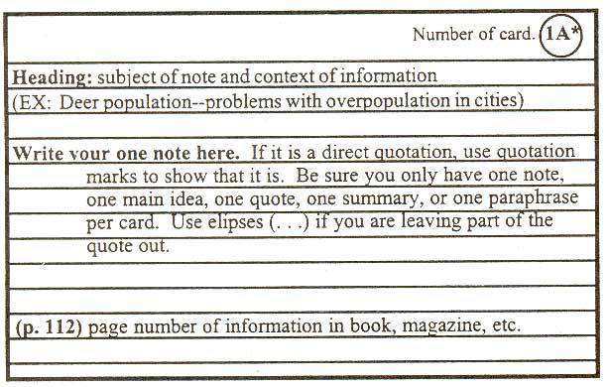
Notetaking options
Notecards

Slide 25
Notetaking options
Research Log
Title:
Author:
Publishing info:
Date:
Page:
Other info:
Primary or Secondary
Record notes here

Slide 26
Notetaking options
Research Log
Title:
Author:
Publishing info:
Date:
Page:
Other info:
Primary or Secondary
Title:
Author:
Publishing info:
Date:
Page:
Other info:
Primary or Secondary
Record notes here

Slide 27
Annotated Resource Sets
This is a great way for students to track internet research
Project Title or Subject
(Resource Title Here) | (Resource Title Here) | (Resource Title Here) | (Resource Title Here) | (Resource Title Here) | (Resource Title Here)
(Context) | (Context) | (Context) | (Context) | (Context) | (Context)
(Image)
(Resource Link Here) | (Resource Link Here) | (Resource Link Here) | (Resource Link Here) | (Resource Link Here) | (Resource Link Here)

Slide 28
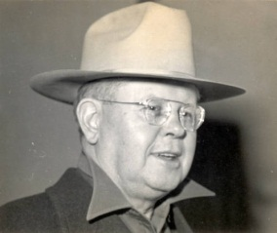
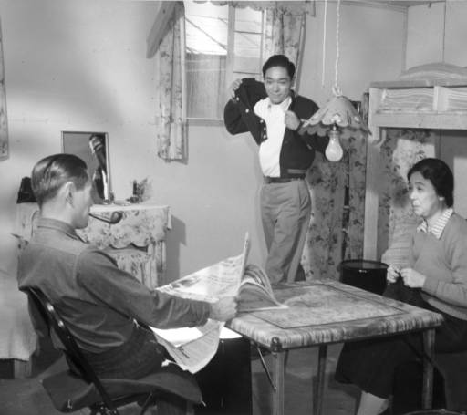
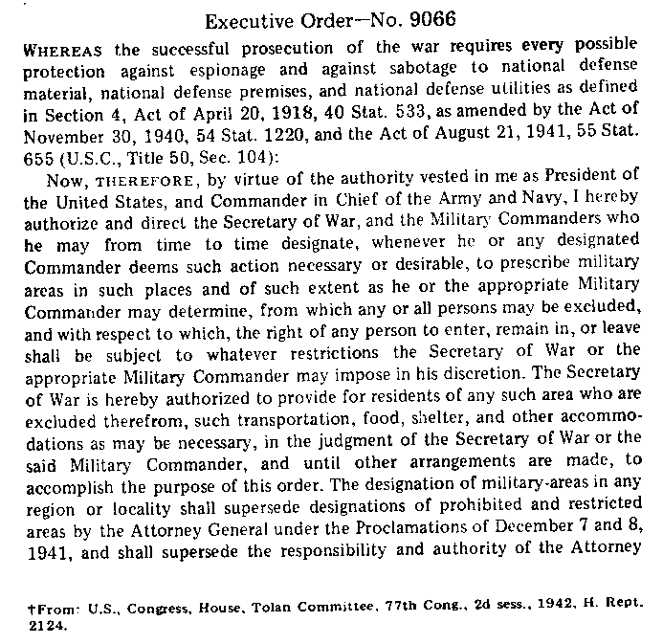
Annotated Resource Sets
Resource Set Governor Ralph Carr
(Resource Title Here) | Ralph L. Carr | The Ninomiya family in their barracks room at the Amache Center | Executive Order 9066 | (Resource Title Here) | (Resource Title Here)
(Context) | This is a photograph of Governor Carr taken while he was Governor of Colorado | This photograph shows what living conditions were like in the barracks | EO 9066 was issued by FDR to mandate the removal of people of Japanese ancestry for the West Coast | (Context) | (Context)
(Image)
(Resource Link Here) | http://cdm16079.contentdm.oclc.org/cdm/singleitem/collection/p15330coll22/id/76409/rec/27 | http://cdm16079.contentdm.oclc.org/cdm/singleitem/collection/p15330coll22/id/3637/rec/2 | http://www.du.edu/behindbarbedwire/executive_order_9066.html | (Resource Link Here) | (Resource Link Here)

Slide 29
Project Phase
This is the opportunity for students to be creative with the things they have learned.
Be sure that the students have read all of the rules for their chosen category before beginning.
Have students view samples before beginning their project.
The project should prove the thesis.
The project must stand on its own.
Judges are most interested in a demonstration of learning, but neatness and creativity are also considered.
Encourage students to include things like maps and timelines when appropriate.
Sometimes the hardest part is deciding what to leave out!

Slide 30
Project Phase
Five categories to choose from
Paper (individual only)
Exhibit (group or individual)
Documentary (group or individual)
Performance (group or individual)
Website (group or individual)
Some projects are better suited to a specific category
Topics that have available video work well in the doc category
Topics where there are not a lot of visual support might make a better paper than an exhibit

Slide 31
Project Phase
Finding examples and specific details about each categories:
www.nhddenver.org
www.nationalhistorydayincolorado.org
www.nhd.org

Slide 32
Quality Control
While students must be the researchers and creators of their projects, teachers play an important role.
The priority of NHDC is student success.
Students will be more successful in the competition phase if they have been through an evaluation and had a chance to improve.
Please, do not let projects come to regionals with grievous errors.

Slide 33
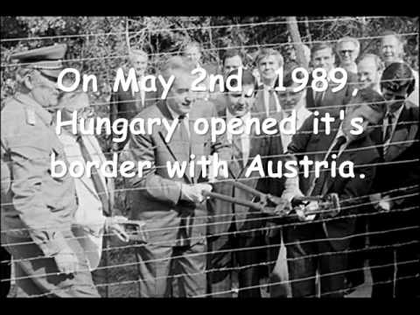
Quality Control
Spelling, Usage and Mechanics
These are not every student’s strong point, but your job is to point our errors so they can be corrected.

Slide 34
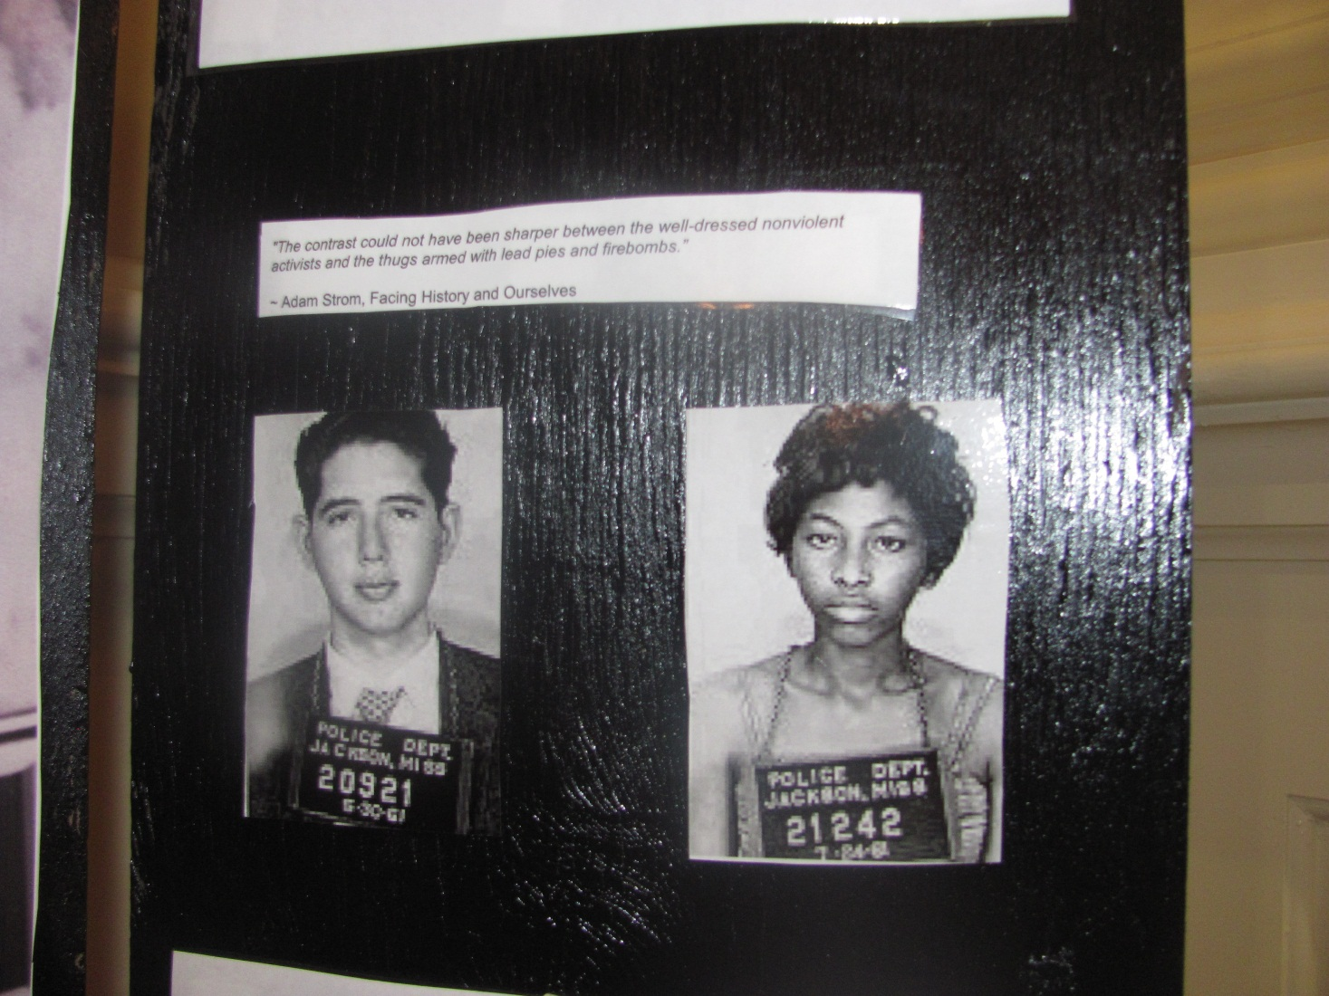
Quality Control
Neatness
Projects should look neat and be carefully produced
This example shows cuts that are not
neat and not neatly backed.

Slide 35
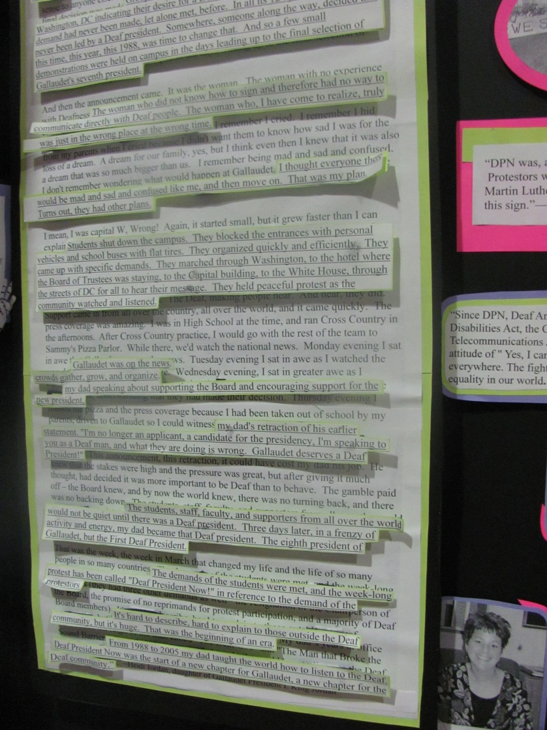
Quality Control
Neatness
Projects should look neat and be carefully produced.

Slide 36
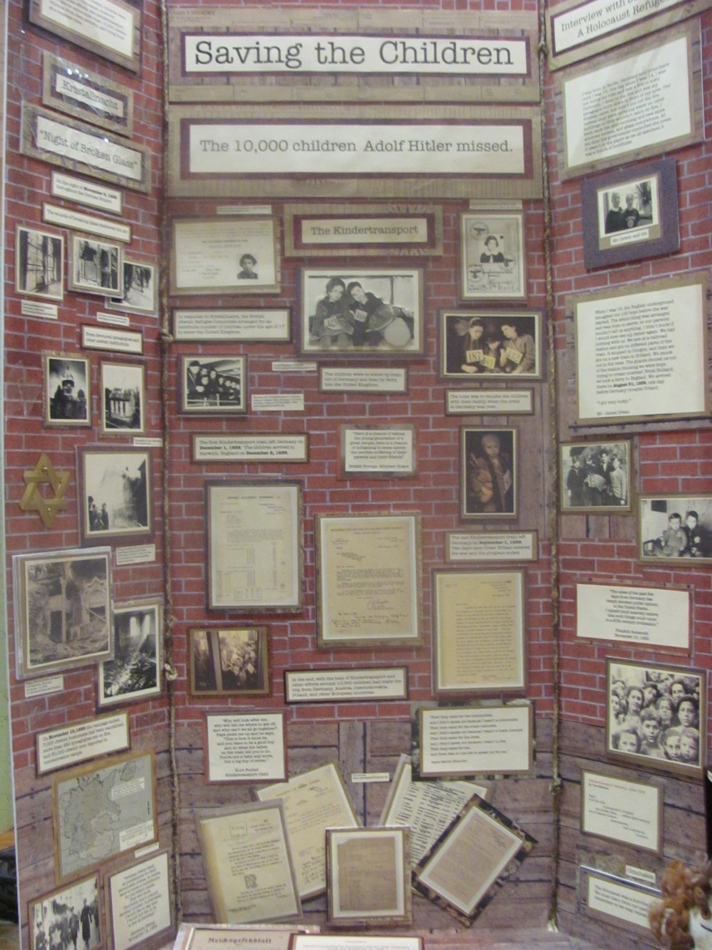
Quality Control
Neatness
Projects should look neat and carefully produced.
This is a good example of a neatly produced project.

Slide 37
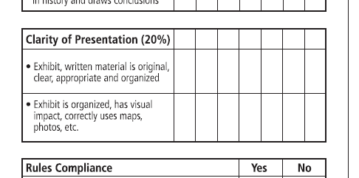
Quality Control
Creativity
Projects that have a visual impact score points with the judges.

Slide 38
This project is laid out in a neat fashion, and it uses many different design elements.

Slide 39
This project shows a creative use of shape.

Slide 40
A creative tabletop display can be a good way to show physical artifacts. If this case, they were encased for security and safety.

Slide 41
This map/timeline display shows a creative use of the table space. While students must produce their own product, parents and teachers can supervise if something is difficult or dangerous. This display included wiring, so the students were taught to do the wiring by an adult, then they did it themselves.

Slide 42
Note the backboard on this display. Students can be creative when creating all parts of their display. In the performance category, backdrops and props are allowed.

Slide 43
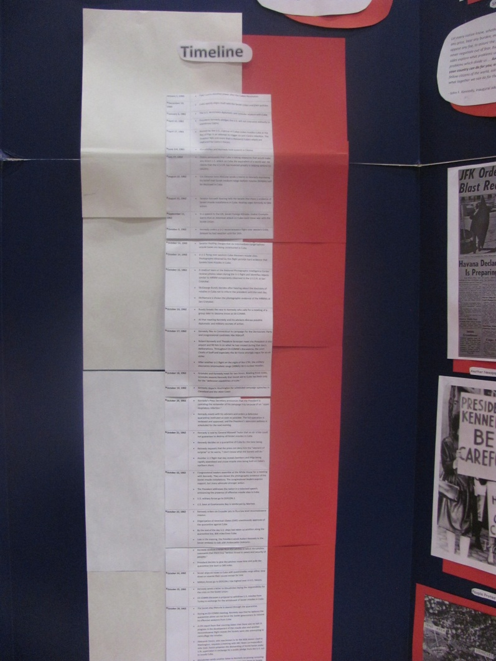
Quality Control
Showing a variety of perspectives
Can the students show chronological or geographical aspects
An example of a timeline that is not very neatly presented.

Slide 44
A more creative example of a timeline.

Slide 45
A more creative example of a timeline.

Slide 46
A more creative example of a timeline.

Slide 47
A creative use of a map within an exhibit.

Slide 48
Greater Denver Metro Competition
Saturday, March 11, 2017
UC Denver, Auraria Campus
Registration: 7:30—9:00 (Exhibits only)
Preliminary Round: 9:00—12:00
Final Round 1:00—3:00
Awards Ceremony: TBD

Slide 49
Greater Denver Metro Competition
Registration
Opens January Monday January 9th; Closes Friday, February 24th
Registration is limited to 5 entries per school per category
A local contest might be necessary to decide which entries to bring

Slide 50
Greater Denver Metro Competition
Entry submission
Papers, websites and docs must be pre-submitted.
Papers: 3 copies of the papers (including annotated bibliography) must be submitted online by March 1st.
Websites must be finalized AND PUBLISHED by March 1st. They will be locked at midnight on March 1st. Once they are locked, they cannot be unlocked. The URL must be submitted at the time of registration.
Documentaries must be uploaded and submitted by March 1st. More details will be available soon.

Slide 51
Greater Denver Metro Competition
Entry submission
Exhibits
Exhibits are displayed at the school on the day of the contest. They must remain in place until the conclusion of final round judging.
Performances
Performances are presented live. All students must be present. All students who worked on the project must play a part in the performance.
Should a final round be necessary, students must be available to present to the judges in the final round.

Slide 52
Greater Denver Metro Competition
Entry submission
Documentaries
All documentaries must be submitted on DVD.
Some DVDs might not run on all equipment. Please have students test their DVD on several players (computer, DVD player, etc.) prior to the contest.
Students should bring a computer that will play their DVD if the school equipment will not run it.
A copy of the DVD must be left with the judges. Students will not be required to be present for the final round of judging.

Slide 53
Good Luck!

